Slide 1

Linear Regression
By : Talib Sir
AI/ML

Slide 2
Linear Regression in Machine learning
Machine Learning is a branch of Artificial intelligence that focuses on the development of algorithms and statistical models that can learn from and make predictions on data. Linear regression is also a type of machine-learning algorithm more specifically a supervised machine-learning algorithm that learns from the labelled datasets and maps the data points to the most optimized linear functions. which can be used for prediction on new datasets.
First of we should know what supervised machine learning algorithms is. It is a type of machine learning where the algorithm learns from labelled data. Labeled data means the dataset whose respective target value is already known. Supervised learning has two types:
Classification: It predicts the class of the dataset based on the independent input variable. Class is the categorical or discrete values. like the image of an animal is a cat or dog?
Regression: It predicts the continuous output variables based on the independent input variable. like the prediction of house prices based on different parameters like house age, distance from the main road, location, area, etc.

Slide 3
What is Linear Regression?
Linear regression is a type of supervised machine learning algorithm that computes the linear relationship between the dependent variable and one or more independent features by fitting a linear equation to observed data.
When there is only one independent feature, it is known as Simple Linear Regression , and when there are more than one feature, it is known as Multiple Linear Regression.

Slide 4
Types of Linear Regression
Simple Linear Regression
This is the simplest form of linear regression, and it involves only one independent variable and one dependent variable. The equation for simple linear regression is:
y=β0​+β1​X where:
Y is the dependent variable
X is the independent variable
β0 is the intercept
β1 is the slope
Multiple Linear Regression
This involves more than one independent variable and one dependent variable. The equation for multiple linear regression is:
y=β0​+β1​X+β2​X+………βn​X where:
Y is the dependent variable
X1, X2, …, Xp are the independent variables
β0 is the intercept
β1, β2, …, βn are the slopes

Slide 5
What is the best Fit Line?
Our primary objective while using linear regression is to locate the best-fit line, which implies that the error between the predicted and actual values should be kept to a minimum. There will be the least error in the best-fit line.
The best Fit Line equation provides a straight line that represents the relationship between the dependent and independent variables. The slope of the line indicates how much the dependent variable changes for a unit change in the independent variable(s).

Slide 6
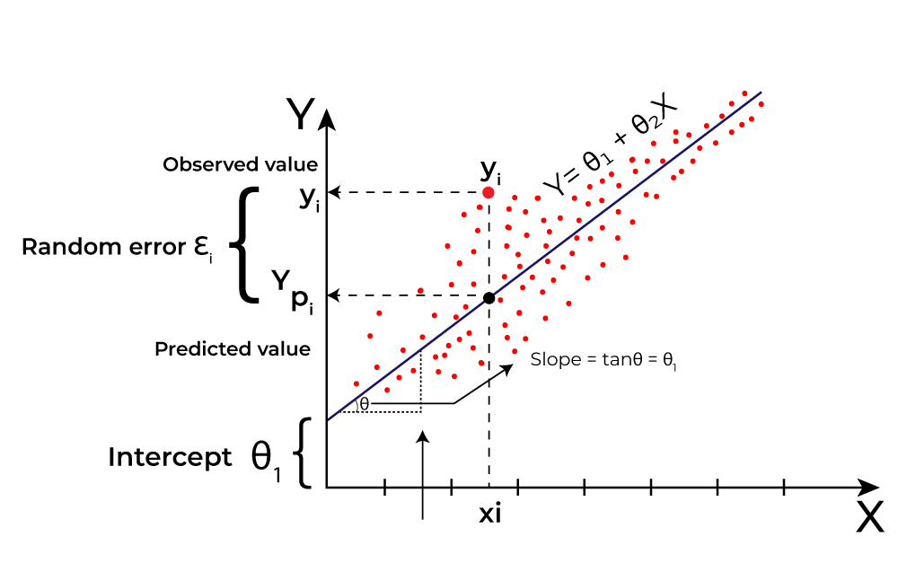
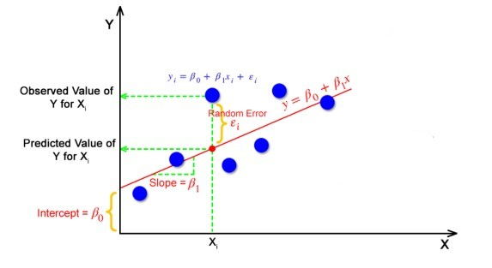
Linear regression performs the task to predict a dependent variable value (y) based on a given independent variable (x)). Hence, the name is Linear Regression. In the figure above, X (input) is the work experience and Y (output) is the salary of a person. The regression line is the best-fit line for our model.

Slide 7
Cost function for Linear Regression
The cost function or the loss function is nothing but the error or difference between the predicted value Y^ and the true value Y.
In Linear Regression, the Mean Squared Error (MSE) cost function is employed, which calculates the average of the squared errors between the predicted values y^​i​ and the actual values yi​. The purpose is to determine the optimal values for the intercept θ1​ and the coefficient of the input feature θ2​ providing the best-fit line for the given data points. The linear equation expressing this relationship is y^​i​=θ1​+θ2​xi​

Slide 8
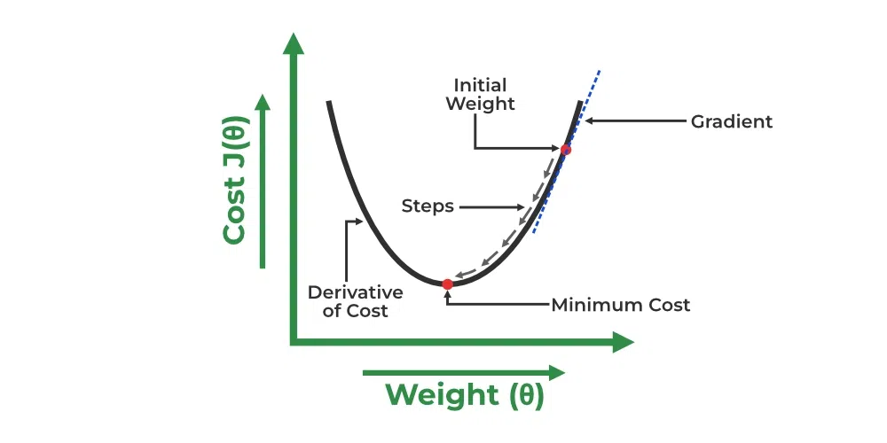
Gradient Descent for Linear Regression
A linear regression model can be trained using the optimization algorithm gradient descent by iteratively modifying the model’s parameters to reduce the mean squared error(MSE)of the model on a training dataset. To update θ₁ and θ₂ values in order to reduce the Cost function (minimizing RMSE value) and achieve the best-fit line the model uses Gradient Descent. The idea is to start with random θ₁ and θ₂ values and then iteratively update the values, reaching minimum cost.

Slide 9
Mean Square Error (MSE)
Mean Squared Error (MSE)is an evaluation metric that calculates the average of the squared differences between the actual and predicted values for all the data points. The difference is squared to ensure that negative and positive differences don’t cancel each other out.
Mean Absolute Error (MAE)
Mean Absolute Error is an evaluation metric used to calculate the accuracy of a regression model. MAE measures the average absolute difference between the predicted values and actual values.
Root Mean Squared Error (RMSE)
The square root of the residuals’ variance is the Root Mean Squared Error. It describes how well the observed data points match the expected values, or the model’s absolute fit to the data.

Slide 10
Coefficient of Determination (R-squared)
R-Squared is a statistic that indicates how much variation the developed model can explain or capture. It is always in the range of 0 to 1. In general, the better the model matches the data, the greater the R-squared number.
In mathematical notation, it can be expressed as: R2=1−(SSE/MSE​)
Adjusted R-Squared Error
Adjusted R² measures the proportion of variance in the dependent variable that is explained by independent variables in a regression model. Adjusted R-square accounts the number of predictors in the model and penalizes the model for including irrelevant predictors that don’t contribute significantly to explain the variance in the dependent variables.
AdjustedR2=1–(n−k−1(1−R2).(n−1)​)
Here,
n is the number of observations
k is the number of predictors in the model
R² is coffecient of determination

Slide 11
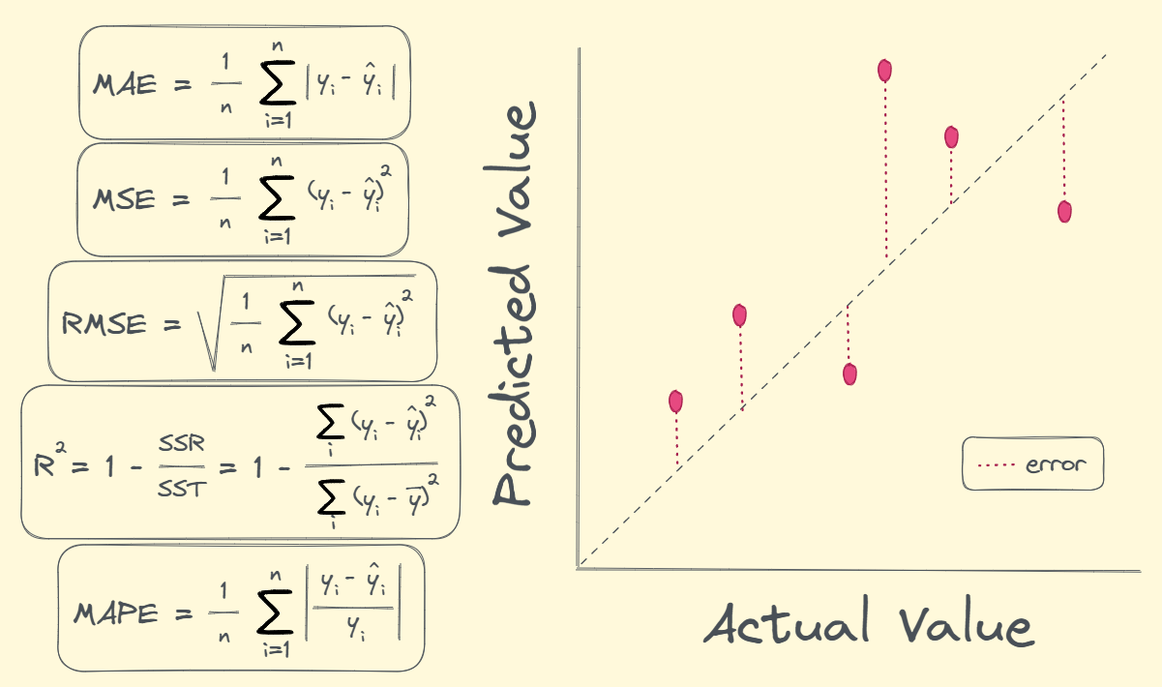
Performance metrics for regression

Slide 12
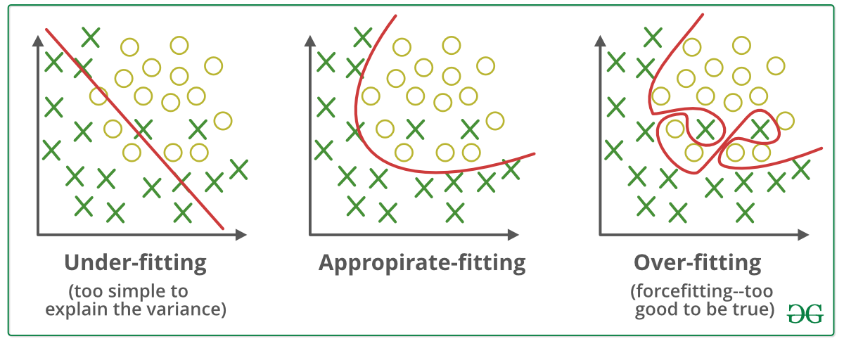
Bias Variance Tradeoff
High Bias
Low Variance
Low Bias
Low Variance
Low Bias
High Variance
Training accuracy = 65%
Testing accuracy = 60%
Training accuracy = 90%
Testing accuracy =70%

